Slide 1
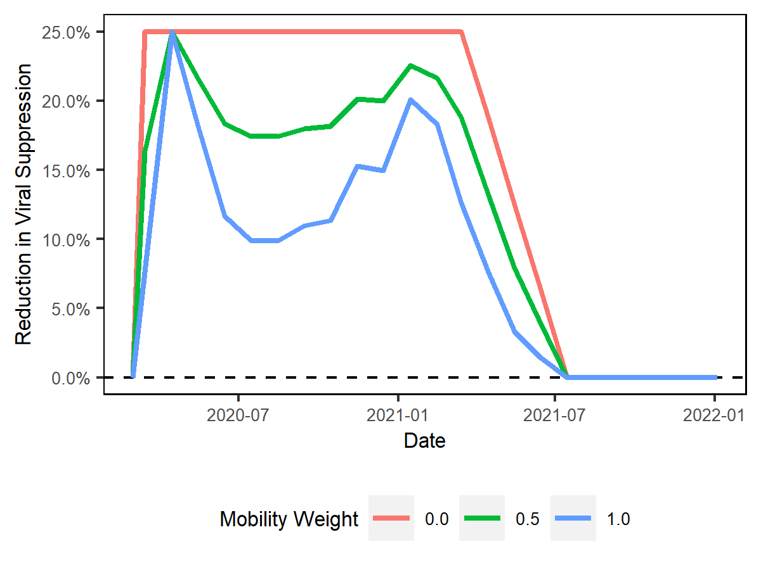
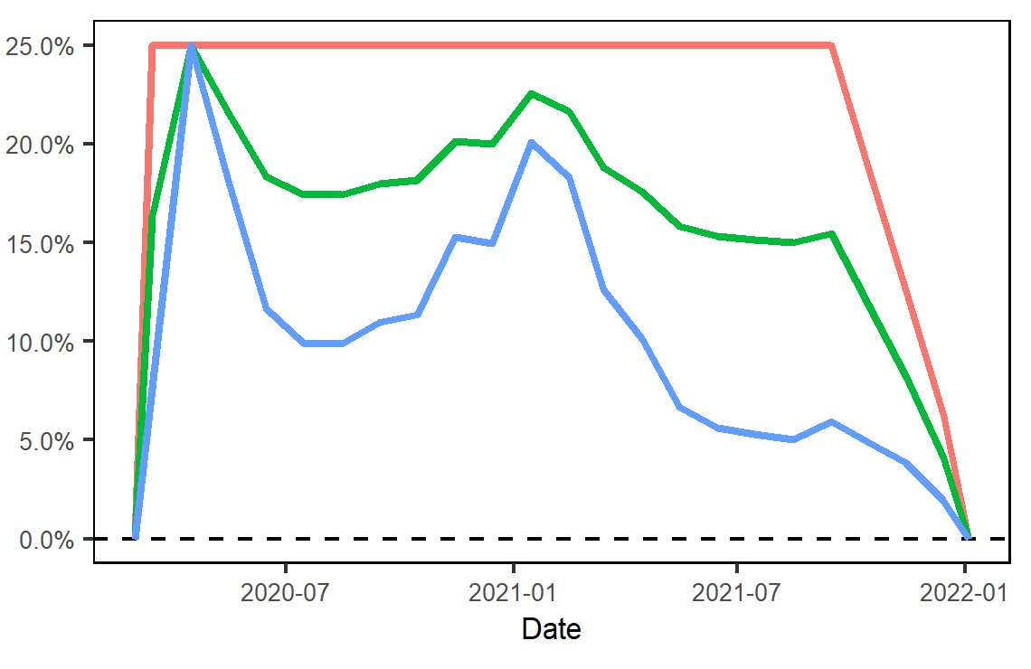
Rapid Resumption of Care
Prolonged Barriers to Care
Begin effect taper
Begin effect taper

